Slide 1
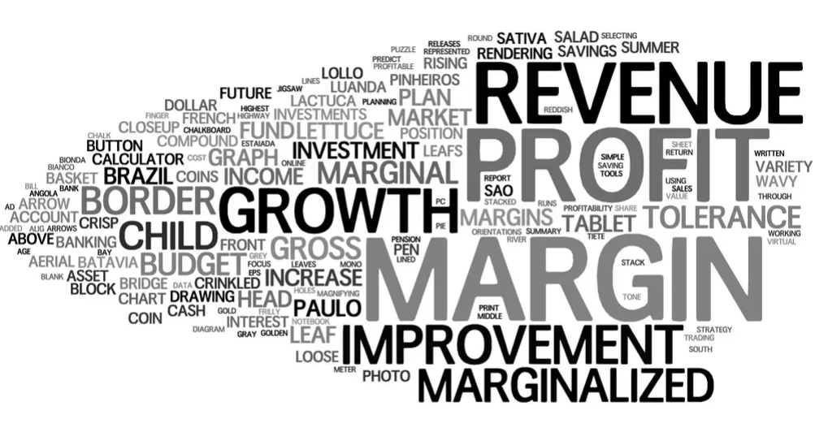
Potential Cases
Sales Intelligence for Account Engagement
Earnings Sentiment Analysis
Text Mining Flow
Systematically analyzes earnings call transcripts, SEC filings, and conference presentations for key trends and outliers
Identify critical insights and understand more about the categories that matter for us
Identify top topics mentioned most frequently and categorizing each topic by using text analytics
Identify new insights, spot outliers, or explore areas
Inputs
Outputs
ANNUAL
REPORT
ALGORITHM
WORD CLOUD
BUSINESS
TECHNOLOGY
PORTFOLIO
QUARTERLY TRANSCRIPT
TOPIC
MODELLING
QUATERLY RESULT
BU Level
QUATERLY PRESS-RELEASE
SENTIMENT ANALYSIS
PSL Level
S-1 FILINGS
Notes:
Topic Analysis
Each transcript is processed through a topic analysis to identify top topics mentioned most frequently and categorizing each topic.
- Counts are aggregated by topic category, including: ESG, Payout, Growth, Capital Structure, Capital Efficiency, Valuation, and Other.
https://www.nasdaq.com/nasdaq-ir-intelligence/earnings-season-machine-learning
https://rstudio-pubs-static.s3.amazonaws.com/615843_4ca8d2a8197b433aa2da9da4552b35d9.html
https://github.com/EricHe98/Financial-Statements-Text-Analysis

Slide 2
Topic Modelling
Topic | Key Words
Hiring | Jobs, Job posting, positions, tech talent, team, hiring, hire, job fair, recruit, graduate hire, graduate program, online job, planning to add, workers, employees, create jobs, virtual hire, to hire, remote job, new hires, to hire engineer, to recruit, to create, skills, workforce, training, skills,
Layoff | Layoff, laying off, fire, resign, to layoff, set to close, massive layoff, to cut, pay cut, slashing salaries, salary cut, pink slip, terminate, cut cost, eliminated jobs, mass layoff, job cut, cut jobs, axe job, job losses, cutting jobs, immediately cut jobs,
CXO Movement | has been appointed, appoints as, names as, joins, appointed as, change in director, join as head of, brings on, hires, to lead, names, to step down,
Expansion (BU, Geo, Stakeholder, Partner, Service Line, Function) | Expands, to anchor new office, to invest, new fulfillment center, announces $mn expansion, double capacity, increase capacity, plans to build, to build a new center, unveils new R&D facility, opens facility, breaks ground on acre park at center, opens store, begins construction, new office building, launches co-innovation space, investing $ million/billion to build a data center, to build tech campus, continues investment, sets up office, R&D hub, pumps $bn, Opens R&D Center, plans to open, renews square foot,
Fundraise and Investments | to invest, raises $million, to invest $mn, secures $million in seed funding, unicorn, pumps $million, gets $million, series A,B, C, D..E round, raise fund
M&A | to sell, to buy, to acquire , sells its subsidiary, announces sale of, announces acquisition, Adds to, buys, to buy, signs deal, acquires, buy of, bolsters, announces completion of the acquisition, % stake, signs agreement to acquire, Paid $Million, agrees to acquire, spinoff, joint venture, JV, Partnership, alliances, collaboration, acquired, acquire, acquisition, Completes Acquisition, Plan to Acquire, Set To Acquire, buys,
Partnership | joint venture, announces collaboration, partners launch, partnership agreement, team up, joins forces, Collaborates, Partners, Expands Strategic Collaboration,
Investments | Investments in Technology (digital + New age), Investments in Platform, High investment on Products innovation, CX, Platform modernization, Other Investments (Mktg, Talent, Branding)
Products/Portfolio | New product launch, product recall, new product development, product modernization
CXO Commentary
Regulatory Action | Regulatory/ Compliance Issues, Company files required legal paperwork; Company has experienced legal difficulties; Company encounters problems with governing law; Company reports or is tied to security vulnerabilities
Deals/Contracts | Company announces they have landed a principal customer; Signed any big bet/ won a contracts/ won a major customer/ New Logos
Competitor Scan | Worked with any IT/IPPs software vendor, Tier-1, Tier-2 IT partner,
Business Restructuring | Any changes in business model, BU/SBU, new movement in CXO, strategy, Vision

